Slide 1


Slide 2
AGENDA
1
Vue + Vite : Somnak Kalan
2
Option API : Ruen SreyKea
3
Vue + Pina : Mao Meng
Composition API and Script Setup: Vorn Sreymao
4
5
Vue + Tailwindcss: Mao kimKy

Slide 3






VUE 3 and VITE

Slide 4
AGENDA
1.Mean of Vite
2.How to install
3.Benefit of Vite in vue
4.Two part of Vite

Slide 5
Vite Meaning
Vite (French word for "quick“ )is a build tool that aims to provide a faster and leaner development experience for modern web projects.

Slide 6
Install Vue+Vite
npm create vite@latest or npm init vite@latest
select framework: vue
select variant: vue
cd <your project>
npm install or npm i
run server: npm run dev

Slide 7
Benefit of Vite in vue
Help your project work well
Make your application process good
Help your large application run fast and quickly
Spend less time, Just only several minute
Make your work well

Slide 8
Two part of Vite
1.A dev server that provides rich feature enhancements over native ES modules,
for example extremely fast Hot Module Replacement (HMR).
2.A build command that bundles your code with Rollup,
pre-configured to output highly optimized static assets for production.

Slide 9
why vite fast
Vite is really fast, because it leverages native ES modules and doesn't need to
rebuild the whole bundle when something changes

Slide 10
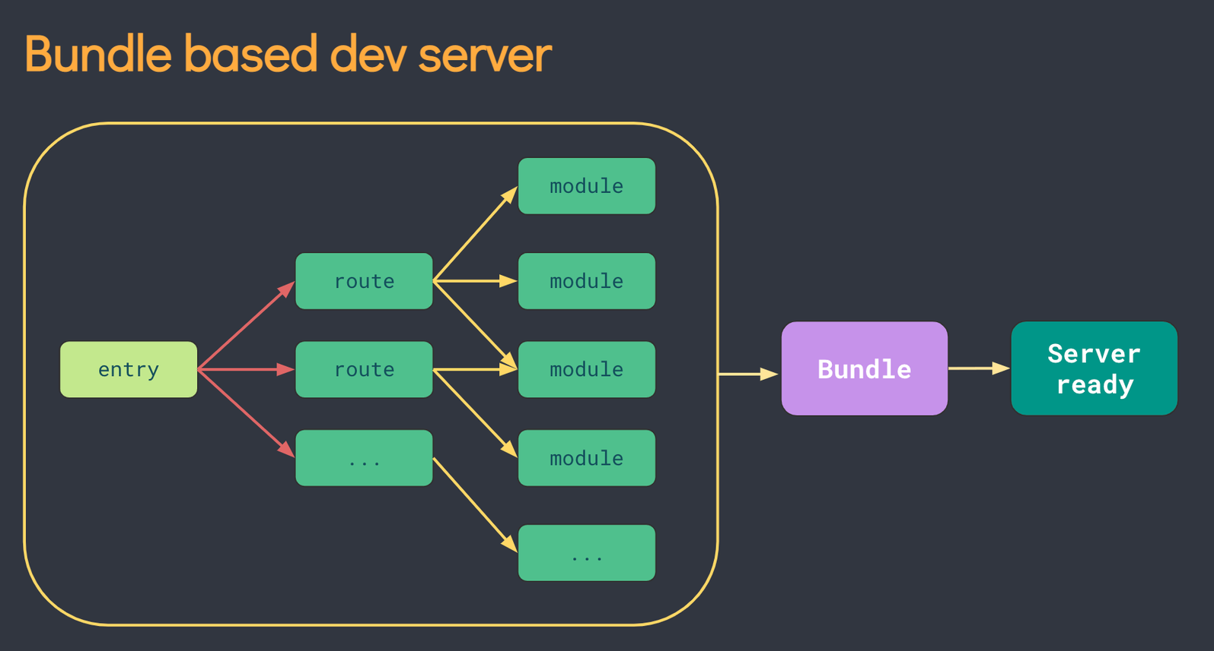
All module it combine into one Bundle

Slide 11
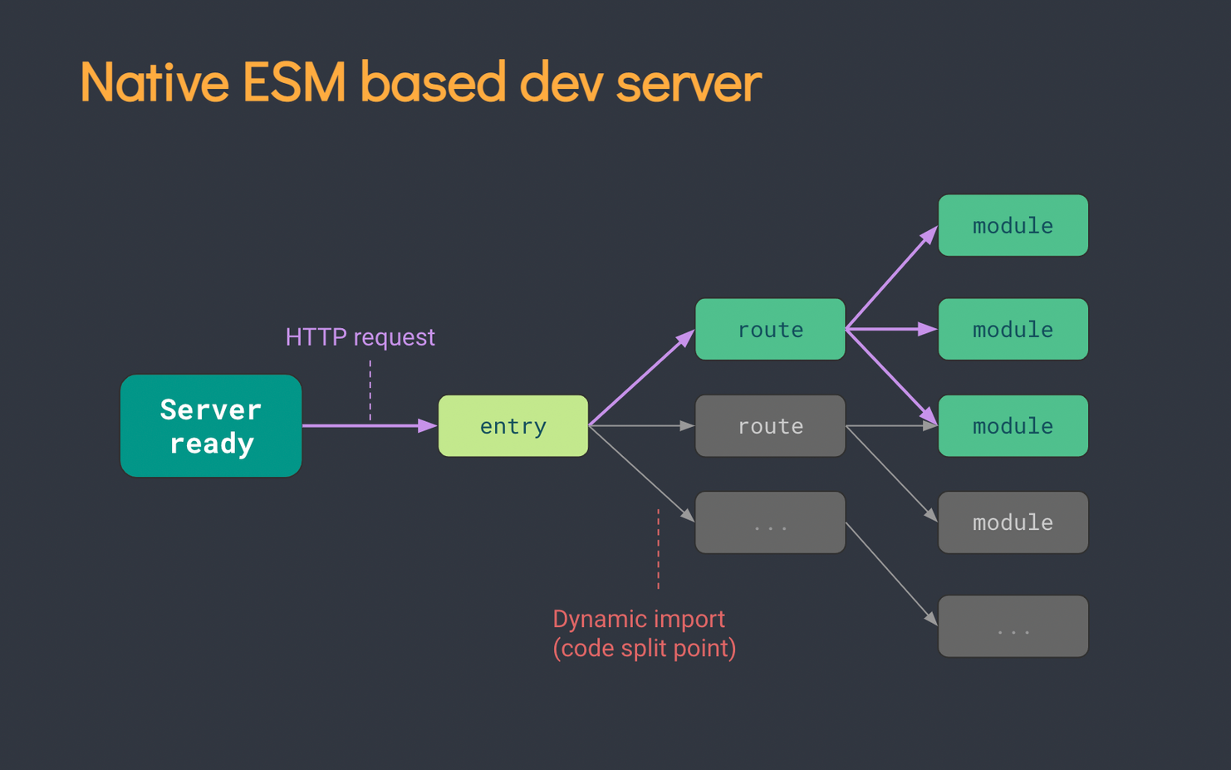
when browser request route Vite only process modules used by this routes.

Slide 12
Thank you

Slide 13

VUE OPTION API

Slide 14
WHAT IS THE OPTIONS API?
Options API in a Vue application to write and define different components. With this API, we can use options such as data, methods, and mounted.

Slide 15

Options STATE
DATA
WATCH
COMPUTED
METHODS

Slide 16
Options STATE
DATA
WATCH
COMPUTED
METHODS

Slide 17
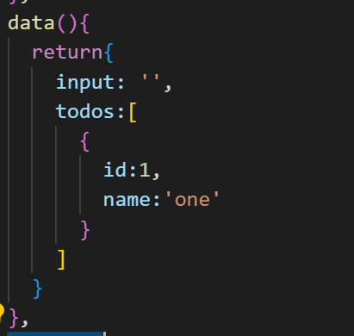
DATA
A function that returns the initial reactive
state for the component instance.

Slide 18
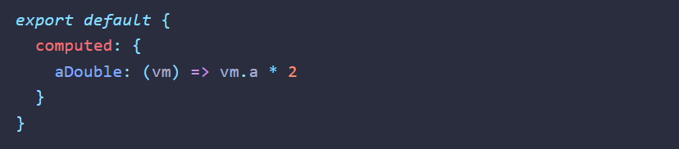
COMPUTED
Declare computed properties to be exposed on the component instance.

Slide 19
WATCH
Declare watch callbacks to be invoked on data change.

Slide 20
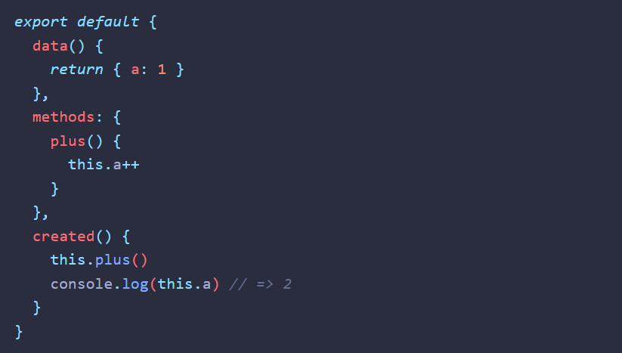
METHODS
Declare methods to be mixed into the component instance.

Slide 21
Reference
https://vuejs.org/api/options-state.html

Slide 22

Pinia Vue
Meng Mao

Slide 23

Pinia is a store library for Vue, it allows you to share a state across components/pages.
Meng Mao

Slide 24
you get a lot from using Pinia:
Devtools support
A timeline to track actions, mutations
Stores appear in components where they are used
Time travel and easier debugging
Hot module replacement
Modify your stores without reloading your page
Keep any existing state while developing
Plugins: extend Pinia features with plugins
Proper TypeScript support or autocompletion for JS users
Server Side Rendering Support
Meng Mao

Slide 25


Composition API
And
Script Setup
TAILWINDCSS
Sreymao Vorn

Slide 26


OBJECTIVES
What is the Composition API and Script Setup?
What is the Script Setup use for?
Benefit of Script Setup
Demo Project
Sreymao Vorn

Slide 27


What is the composition API?
Composition API is a set of APIs that allows us to author Vue components using imported functions instead of declaring options.
Sreymao Vorn

Slide 28
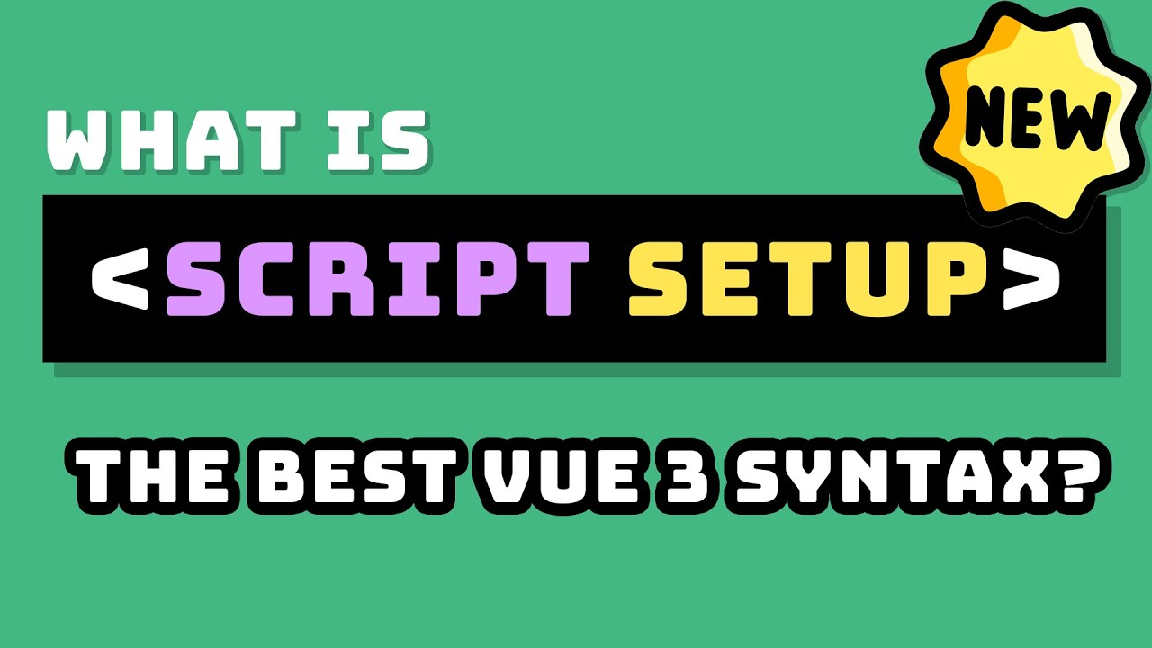
What is the Script Setup?
Script Setup is compile-time syntactic sugar for using Composition API in Single File Components and it allows developers to define components without having to export anything from the JavaScript code block
Sreymao Vorn

Slide 29
Usage of Script Setup
Performance
Code Syntax
Execution Flow
Organizing Code
Sreymao Vorn

Slide 30
Benefit of Script Setup
Better runtime performance
Block code
Group logic together in the setup function
Sreymao Vorn

Slide 31
Thank You
Sreymao Vorn

Slide 32
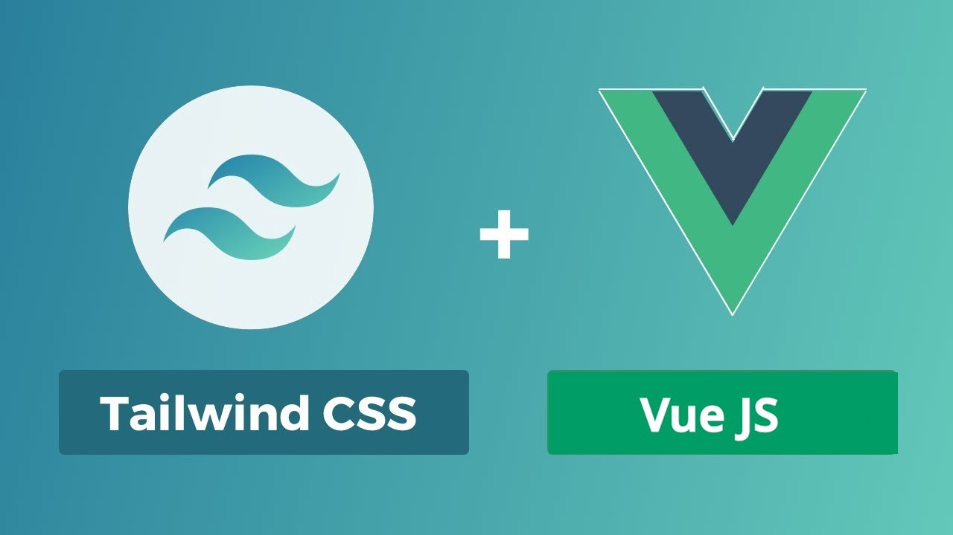
Demo

Slide 33
What is Tailwind CSS ?
Tailwind CSS is basically a utility-first CSS framework for rapidly building custom user interfaces.

Slide 34
Why use Tailwind CSS ?
Faster UI building process
It is a utility-first CSS framework which means we can use utility classes to build custom designs without writing CSS as in traditional approach.
Advantages of Tailwind CSS:
No more silly names for CSS classes and Id’s.
Minimum lines of Code in CSS file.
We can customize the designs to make the components.
Makes the website responsive.
https://tailwindcss.com/docs/reusing-styles#

Slide 35
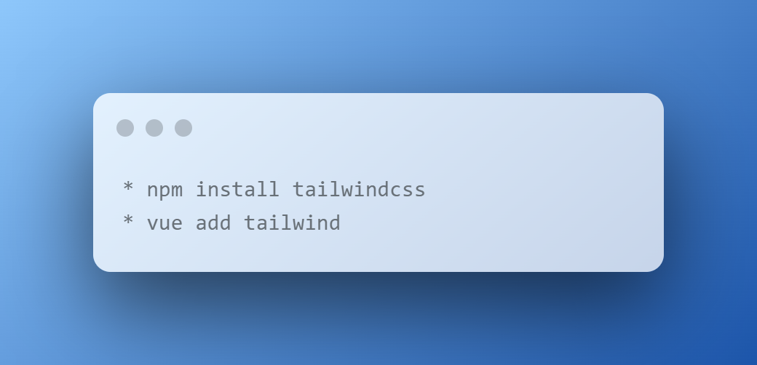
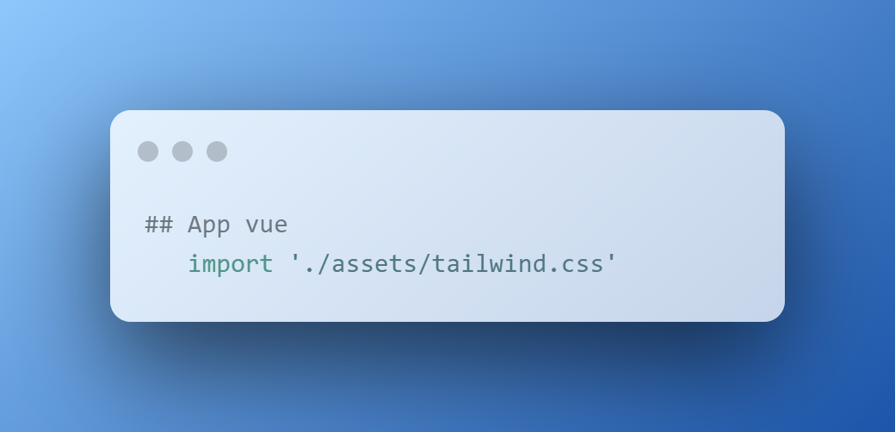
How to use set up Tailwind CSS in Vue 3 ?

Slide 36
Thank You

